Slide 1
Impact of Low Carbon Technologies on networks
Frank Clifton
November 2021
Notes:
End.
Duration – 20 mins talking time, then Q&A after

Slide 2
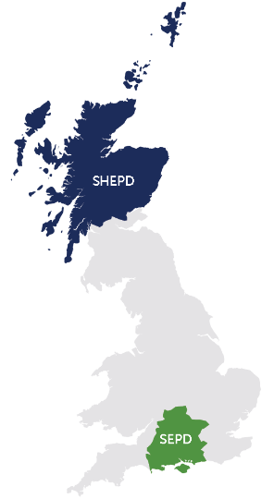
^{SHEPD}
^{780,000 customers’}
^{homes and businesses connected}
^{50,000 km}
^{of overhead lines and}
^{underground/subsea cables}
SSEN today
Scottish and Southern Electricity Networks (SSEN) own and operate two distribution networks and one transmission network.
Core purpose: To provide a safe, secure and reliable supply of electricity to nearly 3.8 million customers.
Vision: To deliver a network that meets both Government ambitions and the aspirations of our customers in a smart, cost-effective and timely manner.
^{SEPD}
^{3,100,000 customers’}
^{homes and businesses connected}
^{78,000 km}
^{of overhead lines and}
^{underground/subsea cables}
80,000
60,000
25,000
EV chargers installed
EVs registered
HPs installed
Notes:
As a Distribution Network Operator (DNO), Scottish and Southern Electricity Networks (SSEN) are responsible for maintaining a secure, reliable and cost-effective electricity network for nearly 3.8 million customers. We now need to provide that same level of service whilst simultaneously facilitating the transition to a decarbonised future; one that meets the UK’s net zero commitment. That represents such a dramatic change that our role will become one of a Distribution System Operator (DSO). The next 30 years will see unprecedented change in the ways that electricity is used, and our role is clear – to ensure both heat and transport can be decarbonised at the scale and pace our stakeholders demand for all the communities we serve.
HUGE raft of changes being proposed by Government to drive EV and HP uptake…
These changes generate numerous questions for us as a business. What does this mean for our assets, our priorities and our stakeholders? How and when should we invest? How big a role will flexibility have? How do we ensure the system is fair? How much does this change across our networks?

Slide 3
Challenges

Slide 4
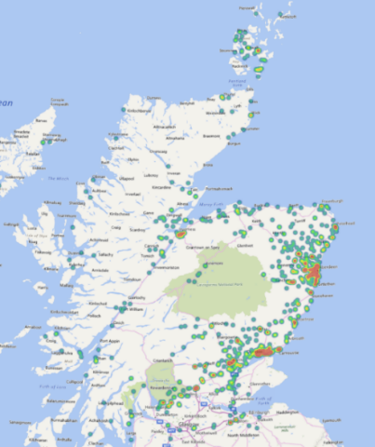
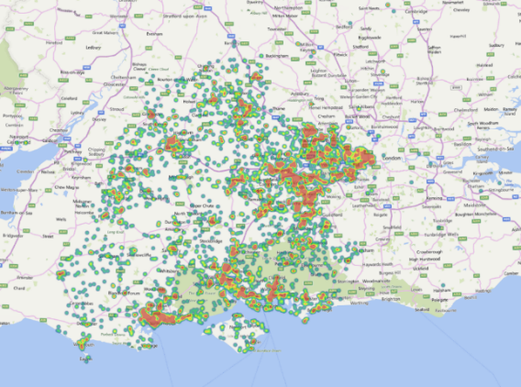
Clustering of EV uptake – current state
Notes:
Whilst numbers for general EV uptake and EV charger installations are interesting, the real challenge for us as network operators is being able to accommodate them at the most granular level on our networks, as uptake is clustering in the early adoption phase and as we’ll see in the next slide the low voltage networks present a particular challenge in supporting the scale and pace of change needed to meet net zero.
The maps on screen here show the installation of domestic charge points on our network – you can see the clusters starting to emerge not only in the main towns and cities, but also villages too.

Slide 5

Network impact
EV charging demand equivalent to a whole property’s demand
Most networks have capacity, but some will be overloaded by this extra load
Can only take low numbers of EV charging to cause issues
Many networks will need investment to facilitate EV and HP uptake
Notes:
It is this particular low voltage element which is of particular concern, as on average networks have been designed to supply around 1-2kW per home, with the diversity in electricity use across homes allowing for this.
• Adding 3.6/7kW to this average demand
– One EV on most streets OK – – But at some point the EV demand could breach the operational limits of a network
Both our My Electric Avenue project and Western Power Distribution’s Electric Nation project found that EV charging demand is the equivalent of another property, which will place a strain a number of networks once uptake ramps up. And in some instances, it takes only a few EVs to overload a network.
NOTE: this is only EVSE, not EVs themselves.

Slide 6
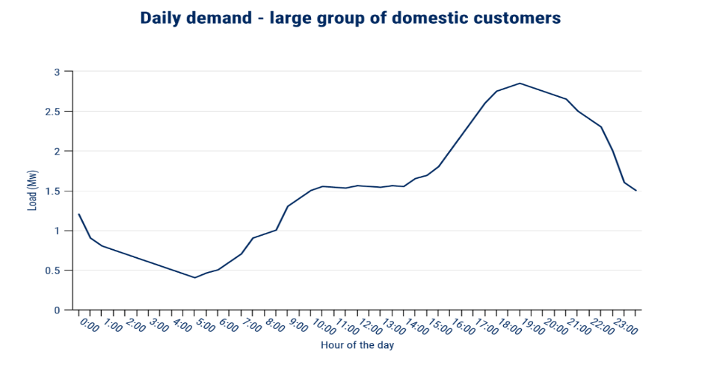
Managing the strain at HV/EHV
Notes:
Whilst this demand growth can present a challenge at all voltages of the network, managing it is easier at higher voltages when the law of large numbers kicks in and the greater customer numbers results in a reduction in the overall variability and a smoother demand profile is seen – such as this chart showing what the demand from a small town or village would typically look like this.

Slide 7


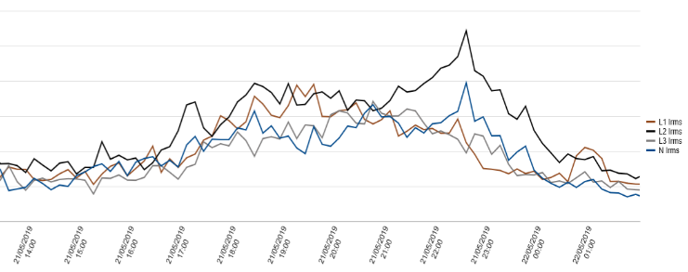

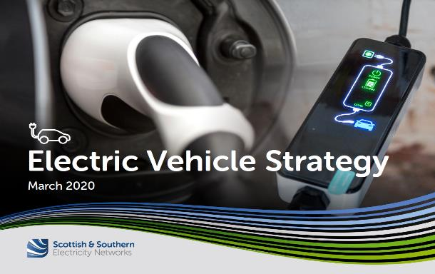
Managing the strain at LV
Digital Strategy
DSO Strategy
Daily demand – small group of customers
2020
Very different profile on LV network
March
Much harder to forecast and manage the changing peaks in demand
Creates need for new processes and tools to manage at a local-level
Notes:
Traditional solutions (like cable replacement, phase balancing, etc.) no longer suitable as cause disruption and not always most efficient investment given that some capacity or voltage constraints might only be for short periods of time.

Slide 8
Our Approach

Slide 9
EV Strategy
Digital Strategy
DSO Strategy
Launched March 2020
2020
March
Developed using stakeholder engagement, innovation and future vision
Builds on sister documents, Digital Strategy & DSO Strategy
Is focused on our stakeholders’ experience

Slide 10
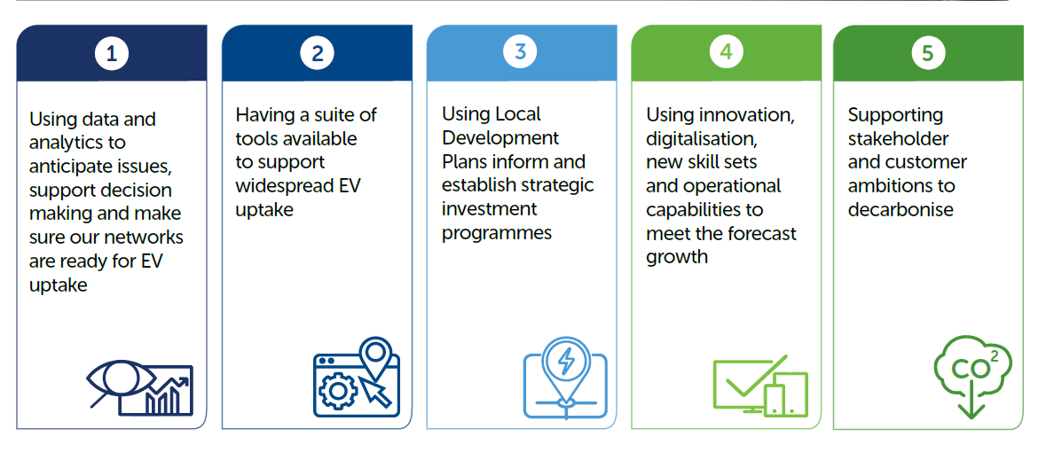

Our strategic approach
How we will facilitate EV uptake and make sure SSEN remains ‘EV ready’
Notes:
Note how data and analytics are the first principle underpinning entire strategy

Slide 11
LV network monitoring
Benefits
Improved network visibility essential for investments
Facilitating flexibility
Facilitating DSO
Certainty in decision making
Improved connections experience
Reduced outages
Using data scientists to pinpoint which networks need monitoring
Strategy is to monitor networks using >80% capacity
Coverage
700 monitors in 2021
21,000 monitors by 2028
Will allow flexibility services to be signposted, procured and triggered

Slide 12
High granularity LCT uptake projections

Slide 13
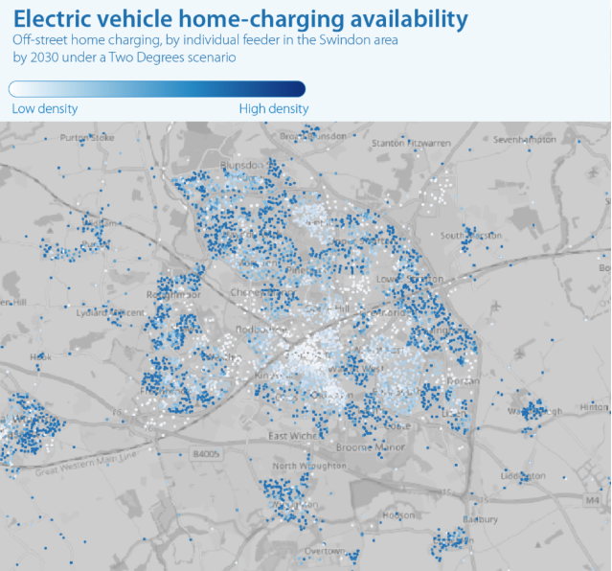
The requirements
EV chargers, HPs and solar PV projections required
Granularity: projections on 400,000 LV feeders and 100,000 distribution substations
For all 4 FES
Numbers and capacities each year to 2050

Slide 14
Low carbon technologies assessed
Heat pumps
Electric
Hybrid gas
8 EV charger archetypes
Domestic off-street charger
Destination
En-route national charging network
En-route local charging station
Car parks
Workplace
On-street chargers
Fleet/ depot
7 vehicle archetypes
Buses and coaches
Cars
LGVs
Motorcycles
Battery electric
Battery electric
Battery electric
Plug-in hybrid
Battery electric
Plug-in hybrid
HGVs
Battery electric
Domestic rooftop solar PV

Slide 15
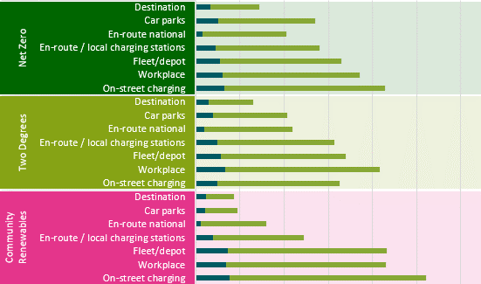
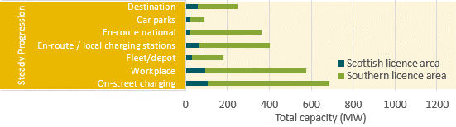
EV charger results highlights
Non domestic off-street EV charger capacity results
Domestic off-street EV charger numbers
Licence area | Scenario | Baseline (thousands) | 2030 (thousands) | 2040 (thousands) | 2050 (thousands)
Scottish licence area | Net Zero | 2 | 146 | 368 | 382
 | Two Degrees | 2 | 134 | 382 | 396
 | Community Renewables | 2 | 134 | 381 | 395
 | Consumer Evolution | 2 | 18 | 200 | 349
 | Steady Progression | 2 | 18 | 202 | 352
Southern licence area | Net Zero | 16 | 984 | 1,594 | 1,594
 | Two Degrees | 16 | 902 | 1,653 | 1,653
 | Community Renewables | 16 | 897 | 1,644 | 1,644
 | Consumer Evolution | 16 | 143 | 843 | 1,299
 | Steady Progression | 16 | 147 | 862 | 1,319

Slide 16
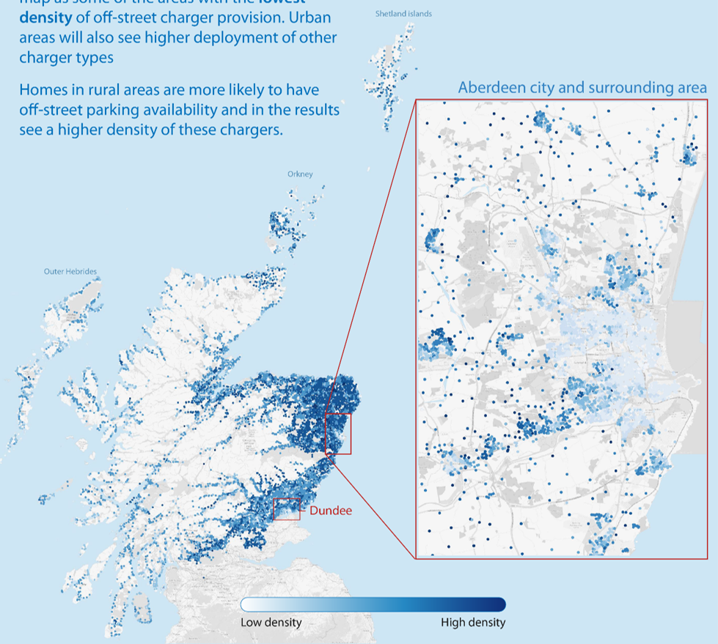
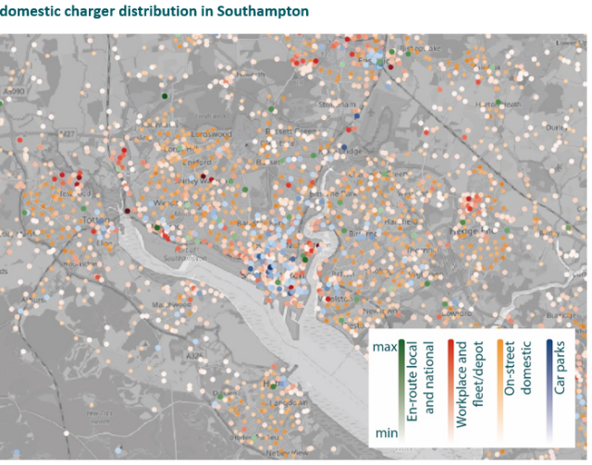
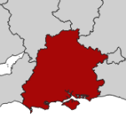

Results highlight
Off-street parking
availability per LV feeder in SSEN’s Scottish licence area
Southampton non-domestic EV charger feeder distribution*
On-street
charger
* Each dot represents a distribution substation

Slide 17
Network impact analysis

Slide 18
Datasets
Regen projections
Assets
Large number of internal and external datasets involved
HV monitoring
Control room
Major effort needed to cleanse and link them together
Customer database
Mapping
PoC used extracts rather than live data
EST Home Analytics
LV monitoring
Numerous data quality challenges
Notes:
Source
Data Required
Maximo MDI
Transformer and feeder ratings, demand readings
Regen – EV projections
Projections of potential EV charger uptake linked to SSEN assets
EST – Home Analytics
Property and social demographic data (property types, gas/non-gas, etc.)
PI
HV transformer/feeder data
LV Monitoring
LV Monitoring data, giving transformer/feeder demand
PowerOn
Network structure
SIMS
MPAN counts
GIS
Mapping data of all SSEN assets
EAC
Estimated annual consumption figures per MPAN

Slide 19
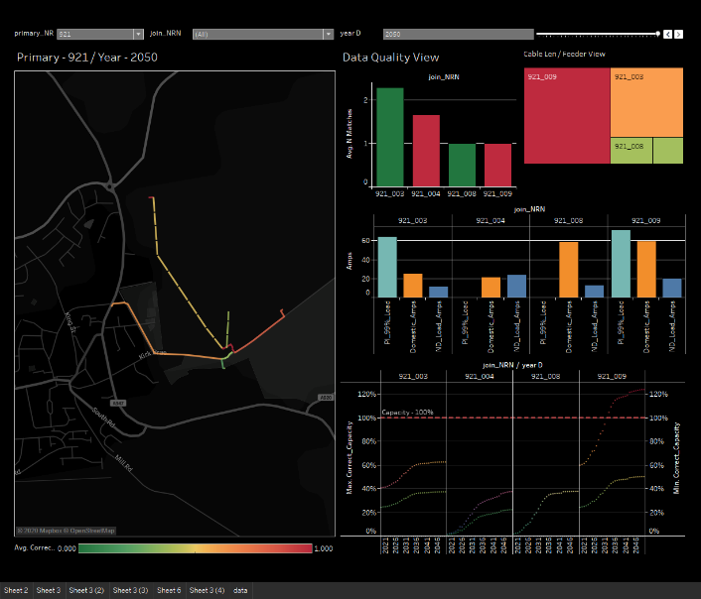
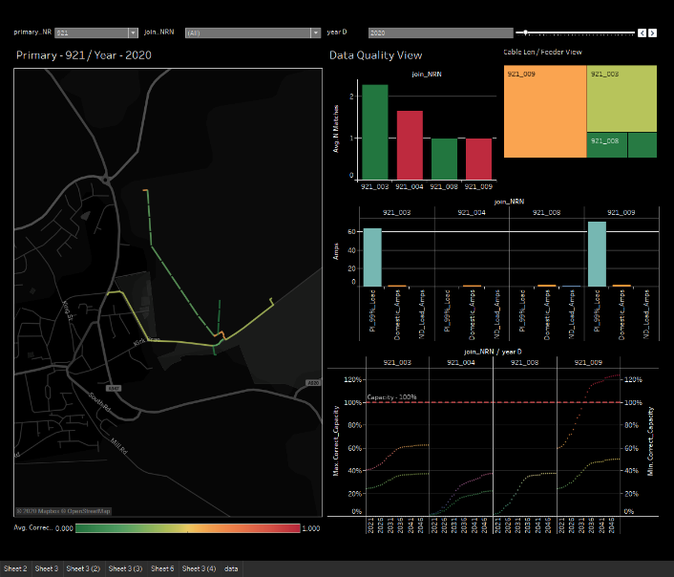
HV feeder view
2020
2050
Geographic visualisation of network
Data quality view plus cable length and RAG status view per feeder
Load split for each feeder
Capacity utilisation shown to 2050 for each feeder plus use of defaults
Notes:
NOTE: animation on this slide to show 2020 to 2050 change in visuals

Slide 20
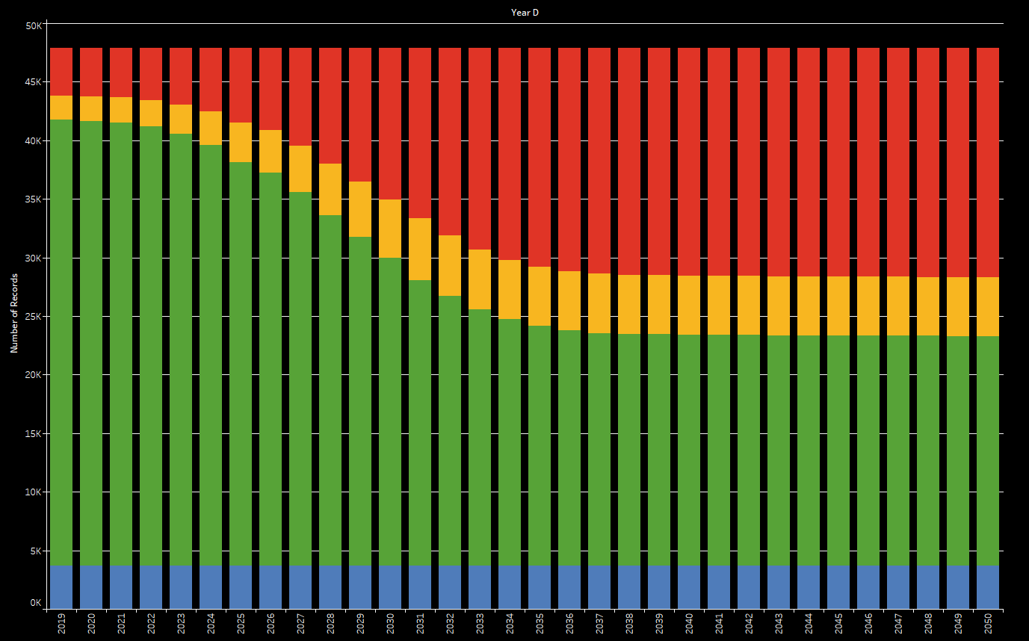
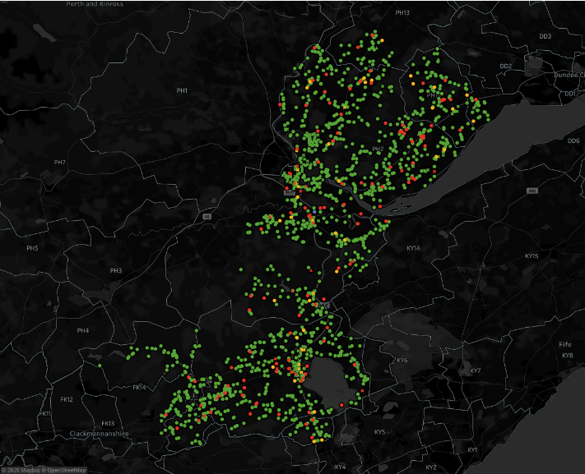
Aggregated yearly views
Simple presentation of yearly volumes of assets in each RAG status
Need a scresnnshot!
Allows us to understand annual volumes as well as where investment needed
Tool provides us with ability to use sliders to quickly see yearly changes across areas
Ensures we can invest to create more capacity or use flexibility to sweat existing assets and connect more chargers

Slide 21
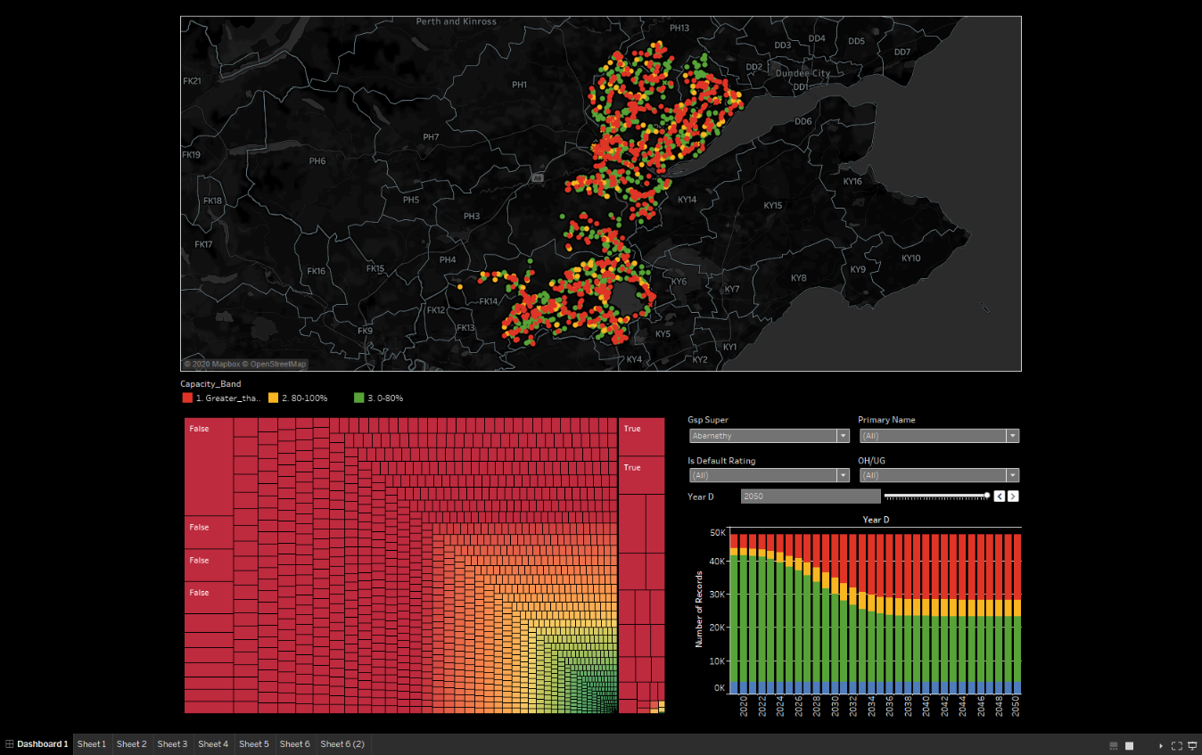
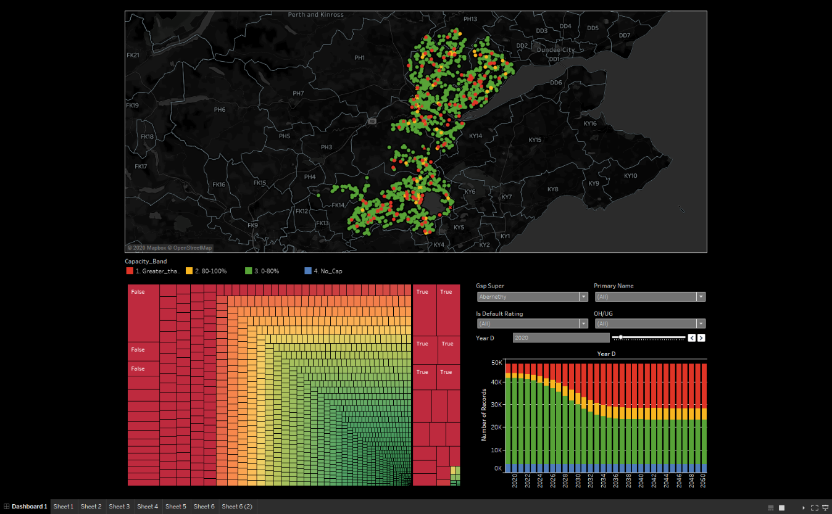

Secondary substation views
2050
2020
Also have views for LV feeders
Can easily view constraints at regional-level or drill down to neighbourhood-level
Will allow us to advise customers and third parties where chargers can connect, and where we need to invest to meet net zero ambitions
Notes:
NOTE: animation on this slide to show 2020 to 2050 change in visuals

Slide 22
SSEN Green Recovery Projects
Following development work, SSEN submitted a total of 12 projects across both SEPD and SHEPD regions to Ofgem for review.
10 projects will provide network reinforcement to support forecasted domestic LCT adoption, as well as the charging of electric car, buses, planes and the reinforcement of two motorway service areas.
2 projects will enable us to further understand the use of power on LV networks which will inform how we resolve constraints and ready those networks for the uptake of technologies like EVs and heat pumps.
All projects submitted to Ofgem were approved and collectively will create 122MW of additional capacity for an estimated investment of £40.92m.
SHEPD project locations and works to be undertaken:
    Dundee (Constable Street) – replacement of two transformers and replacement of underground cable
    Clachan, North Uist – replacement of two transformers and the extension of the existing substation
    Thurso (Ormlie & Mount Pleasant) – installation of two new transformers in both substations
SEPD projects will also be undertaken in Oxfordshire (Wheatley and Witney Town); Hampshire (Bishops Waltham, North Baddesley and Rownhams) and Dorset (Dorchester Town)

Slide 23
Innovation EV projects
Equal EV
Skyline
LEVEL
CrowdFlex
E Tourism
Optimise Prime
Project LEO
Notes:
Equal EV.
Skyline.
LEVEL.
Crowdflex.
E Tourism.
Optimise Prime – >£30m, largest commercial fleet electrification trial – Hitachi, UKPN – fleets of Royal Mail, Centrica, Uber. Looking at identifying challenges and solutions in a toolkit for fleets htat charge at depot/home/public, and how can offer fleets up for flexibility services to earn revenue.
Project LEO (Local Energy Oxfordshire)
Funding source: Innovate UK (via the Smart Local Energy Systems competition)
Funding values: Project costs £36.98m, Funding granted: £11.71m (note both include parts of TRANSITION project spend)
Partners: EDF Energy, Nuvve, Piclo, Oxford City Council, Oxfordshire County Council, The Low Carbon Hub, University of Oxford, Oxford Brookes University
Overview: The UK energy sector is going through a fundamental transition centred around meeting the low carbon generation ambitions, customers' active engagement and technology innovation. Smart, flexible and efficient are key attributes which the existing energy systems infrastructure must acquire to deliver this transition whilst guaranteeing security and affordability - which is at the core of Project LEO.
As Oxfordshire’s energy system becomes increasingly decentralised with existing and emerging low carbon energy projects distributed across the county, it becomes increasingly important to develop a fully connected and integrated energy.
Project LEO addresses key challenges by developing innovative funding models for new assets and demonstrating a world-leading local energy market - an innovative ecosystem that financially rewards participants to enable the deployment of clean generation across a constrained network in the most cost-effective manner. Specifically, it develops new local flexibility and energy markets to maximise the utilisation of the distributed generation, load, storage and network assets to enable innovative business models for investment for a low-carbon and smart energy system.
The local energy market will be facilitated by four marketplace operators: Open Utility, Origami Energy (a sub-contractor to The Low Carbon Hub), EDF Energy, and Nuvve. The Oxford community is represented by the Low Carbon Hub which has 38 local energy projects, over 4MW of generation capacity and deep interactions with circa 30 local energy groups in Oxfordshire. The local public sector (Oxfordshire County Council, Oxford City Council, University of Oxford and Oxford Brookes University) bring flexible load in the form of their estates and smart energy projects from intelligent street lighting, vehicle to grid and responsive heat networks. Project LEO is further enhanced through global leading energy systems research capability brought by the University of Oxford consolidating multiple data sources and analysis tools to deliver a model for future local energy system mapping across all energy vectors. There is further interest from private sector developers to develop smart local energy systems that interact with Project LEO. The partnership represents the entire energy value chain in a compact and focused consortium, and leverages approximately £86 million of asset spend to trial multiple new innovations to maximise the value of local energy.
SSEN role: we will both manage the overall project and bring the core development of a DSO Market Integrator, delivered under the TRANSITION Project, to underpin the localised system approach.

Slide 24
Q&A

Slide 25





Thank you
Connect with us
futurenetworks@sse.com
www.ssen.co.uk/smarterelectricity
@ssencommunity
@ssen_fn
Linkedin.com/company/ssencommunity

