Slide 1

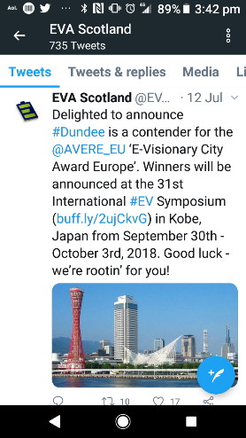

Dundee City Council
Scotland’s Electric City
Fraser Crichton
Corporate Fleet Manager
Dundee City Council
Dundee is Europe's most visionary EV city

Slide 2
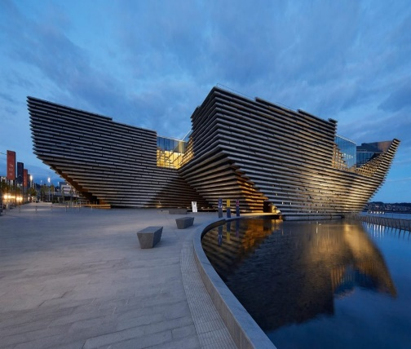
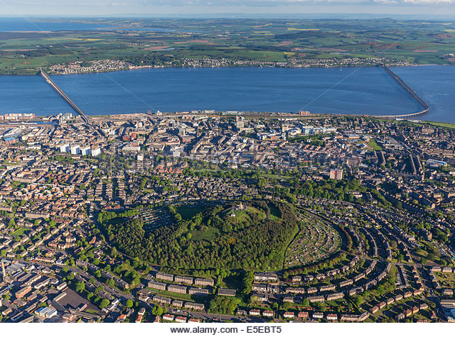
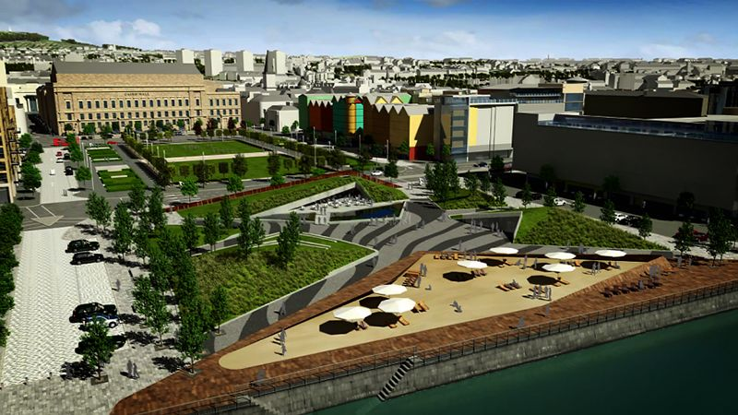
Population 150,000 DUNDEE’S POLLUTED STREETS Area – 60 km sq.
1.1 million visitors 2019
Cities Topographic is Unique

Slide 3
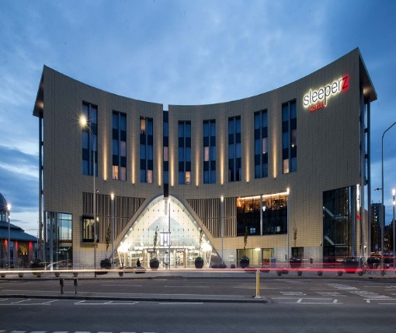
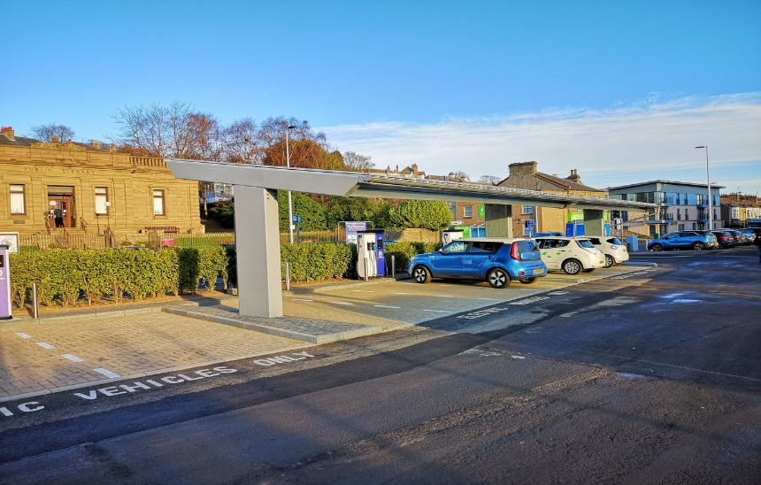
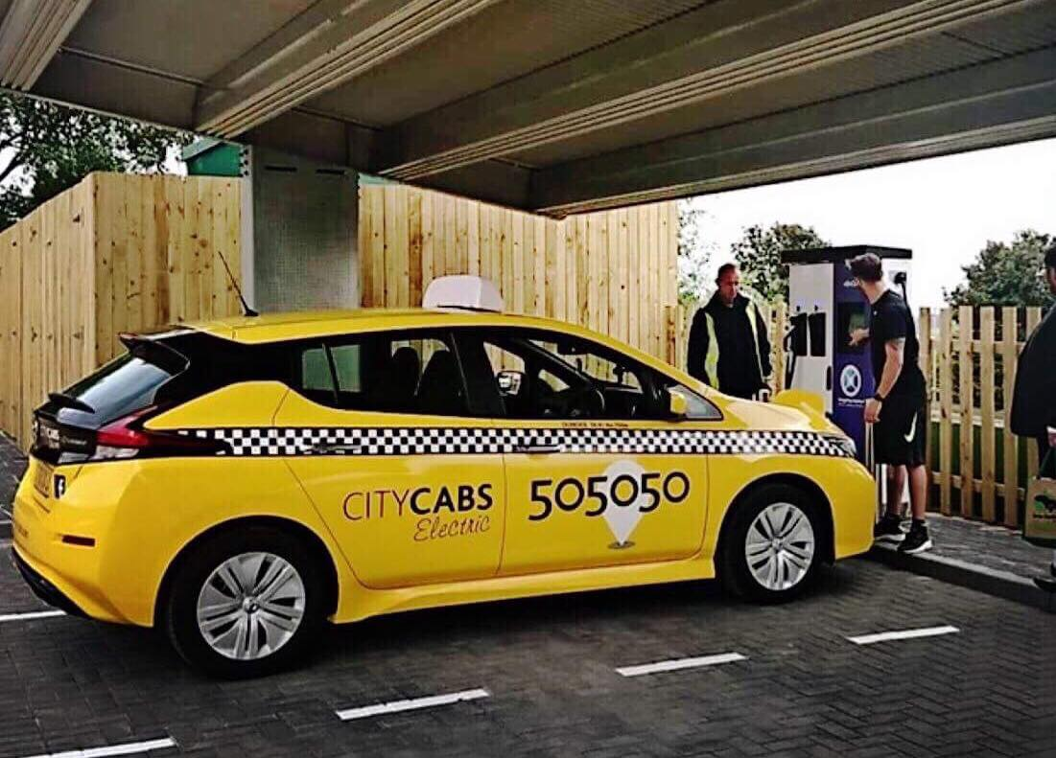
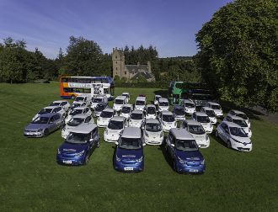
Dundee City Council: “Electrifying a City” means change
Charging Infrastructure Electric Taxis Council EV Fleet

Slide 4

Scottish Government announced its ambition to phase out the need for new petrol and diesel cars and vans by 2032. A key part of this will be encouraging and supporting the take up of Ultra Low Emission Vehicles (ULEVs). Transport Scotland has already made considerable progress in this regard through funding the deployment of one of the most comprehensive public charge point networks in Europe (ChargePlace Scotland) and supporting the installation of workplace chargepoints.
UK / Scotland EV Policies

Slide 5
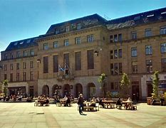
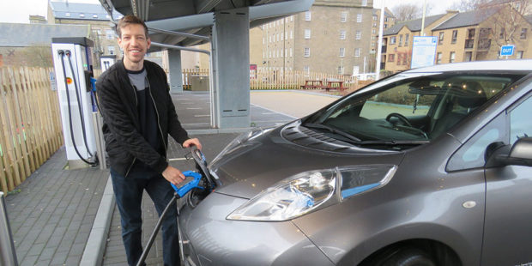
Local Leadership
Council leader – is leading the way in EVs
In August 2018, he and his wife traded in their two petrol cars for one electric-powered Nissan Leaf, a decision that is continuing to benefit the family. Used mainly for the nursery runs and driving to and from council meetings, Cllr Alexander claims his electric vehicle is “the best car” he has ever driven.

Slide 6
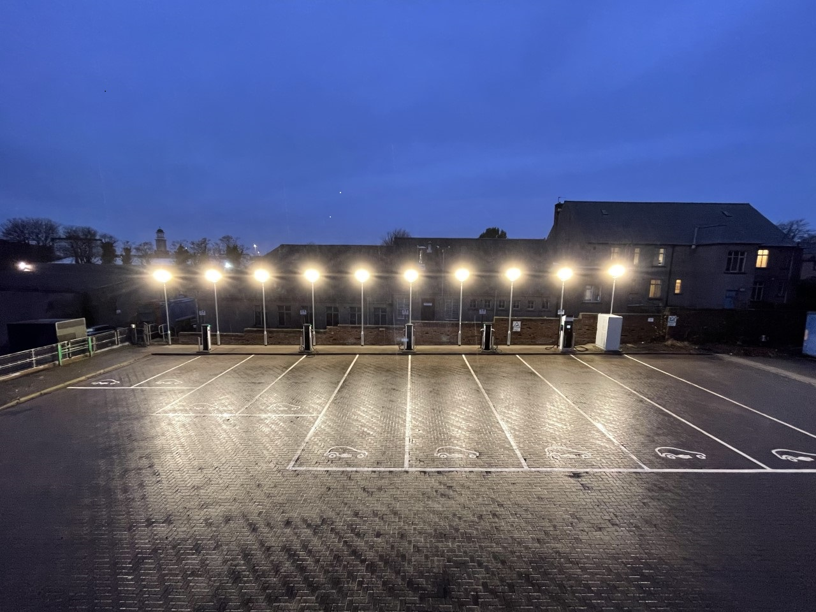
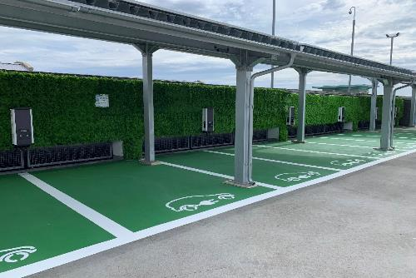
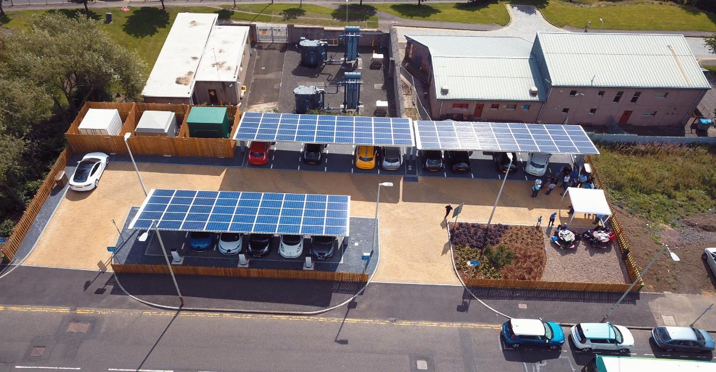
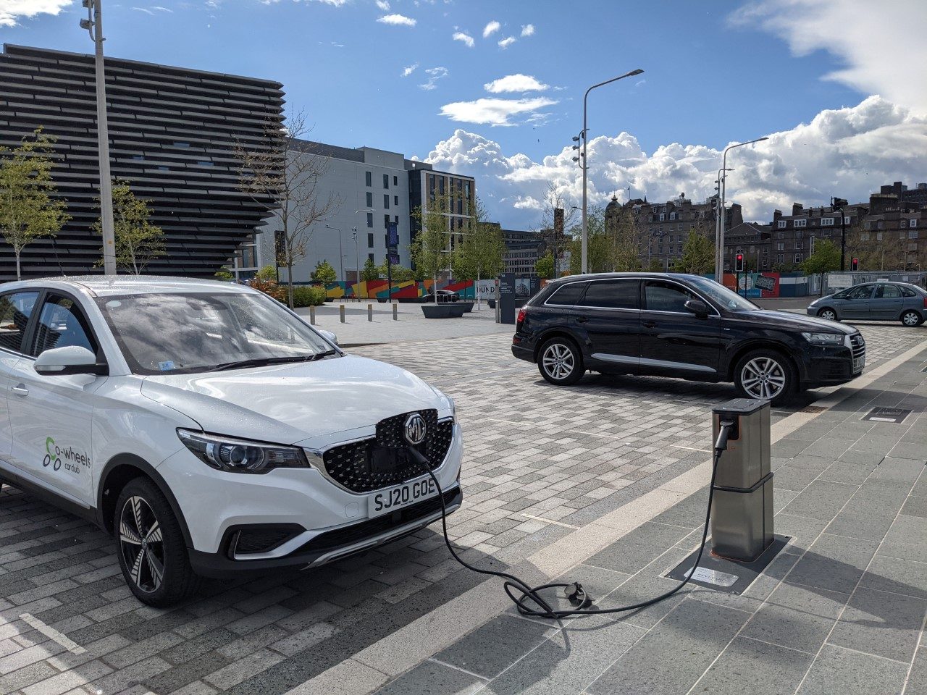
3 Sectors of EV Infrastructure

Slide 7
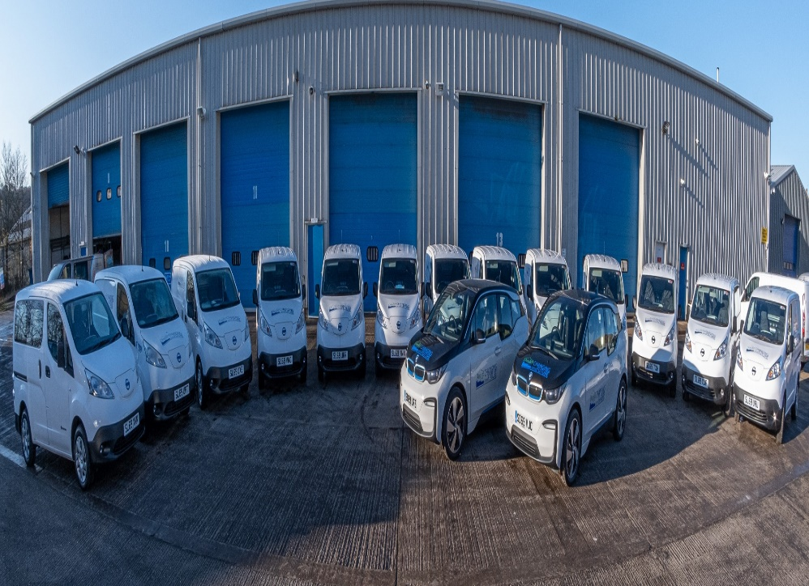
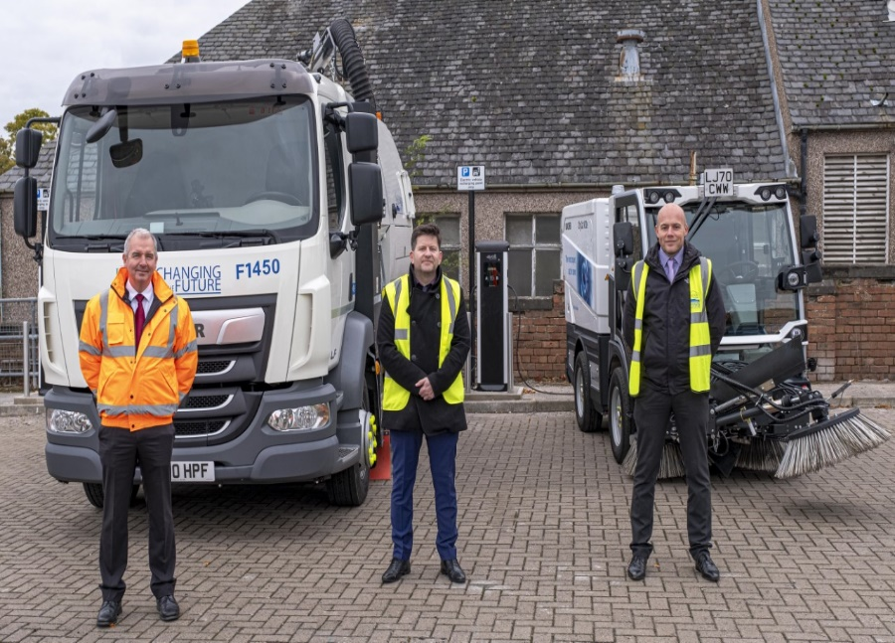
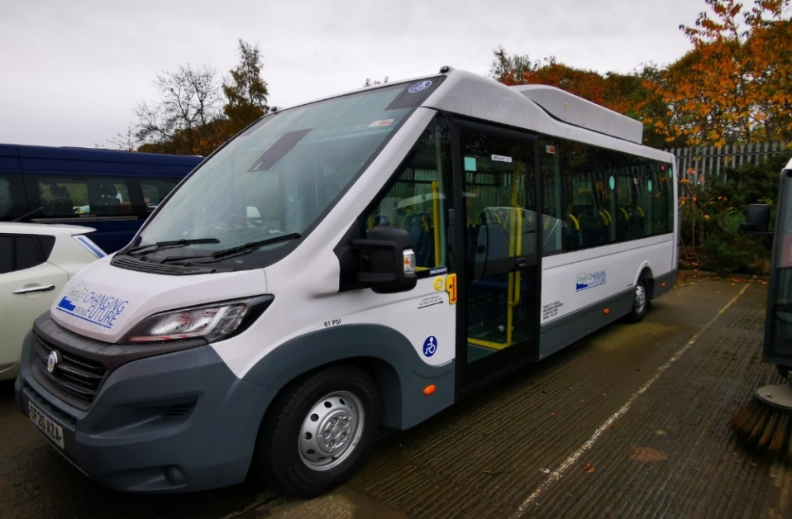
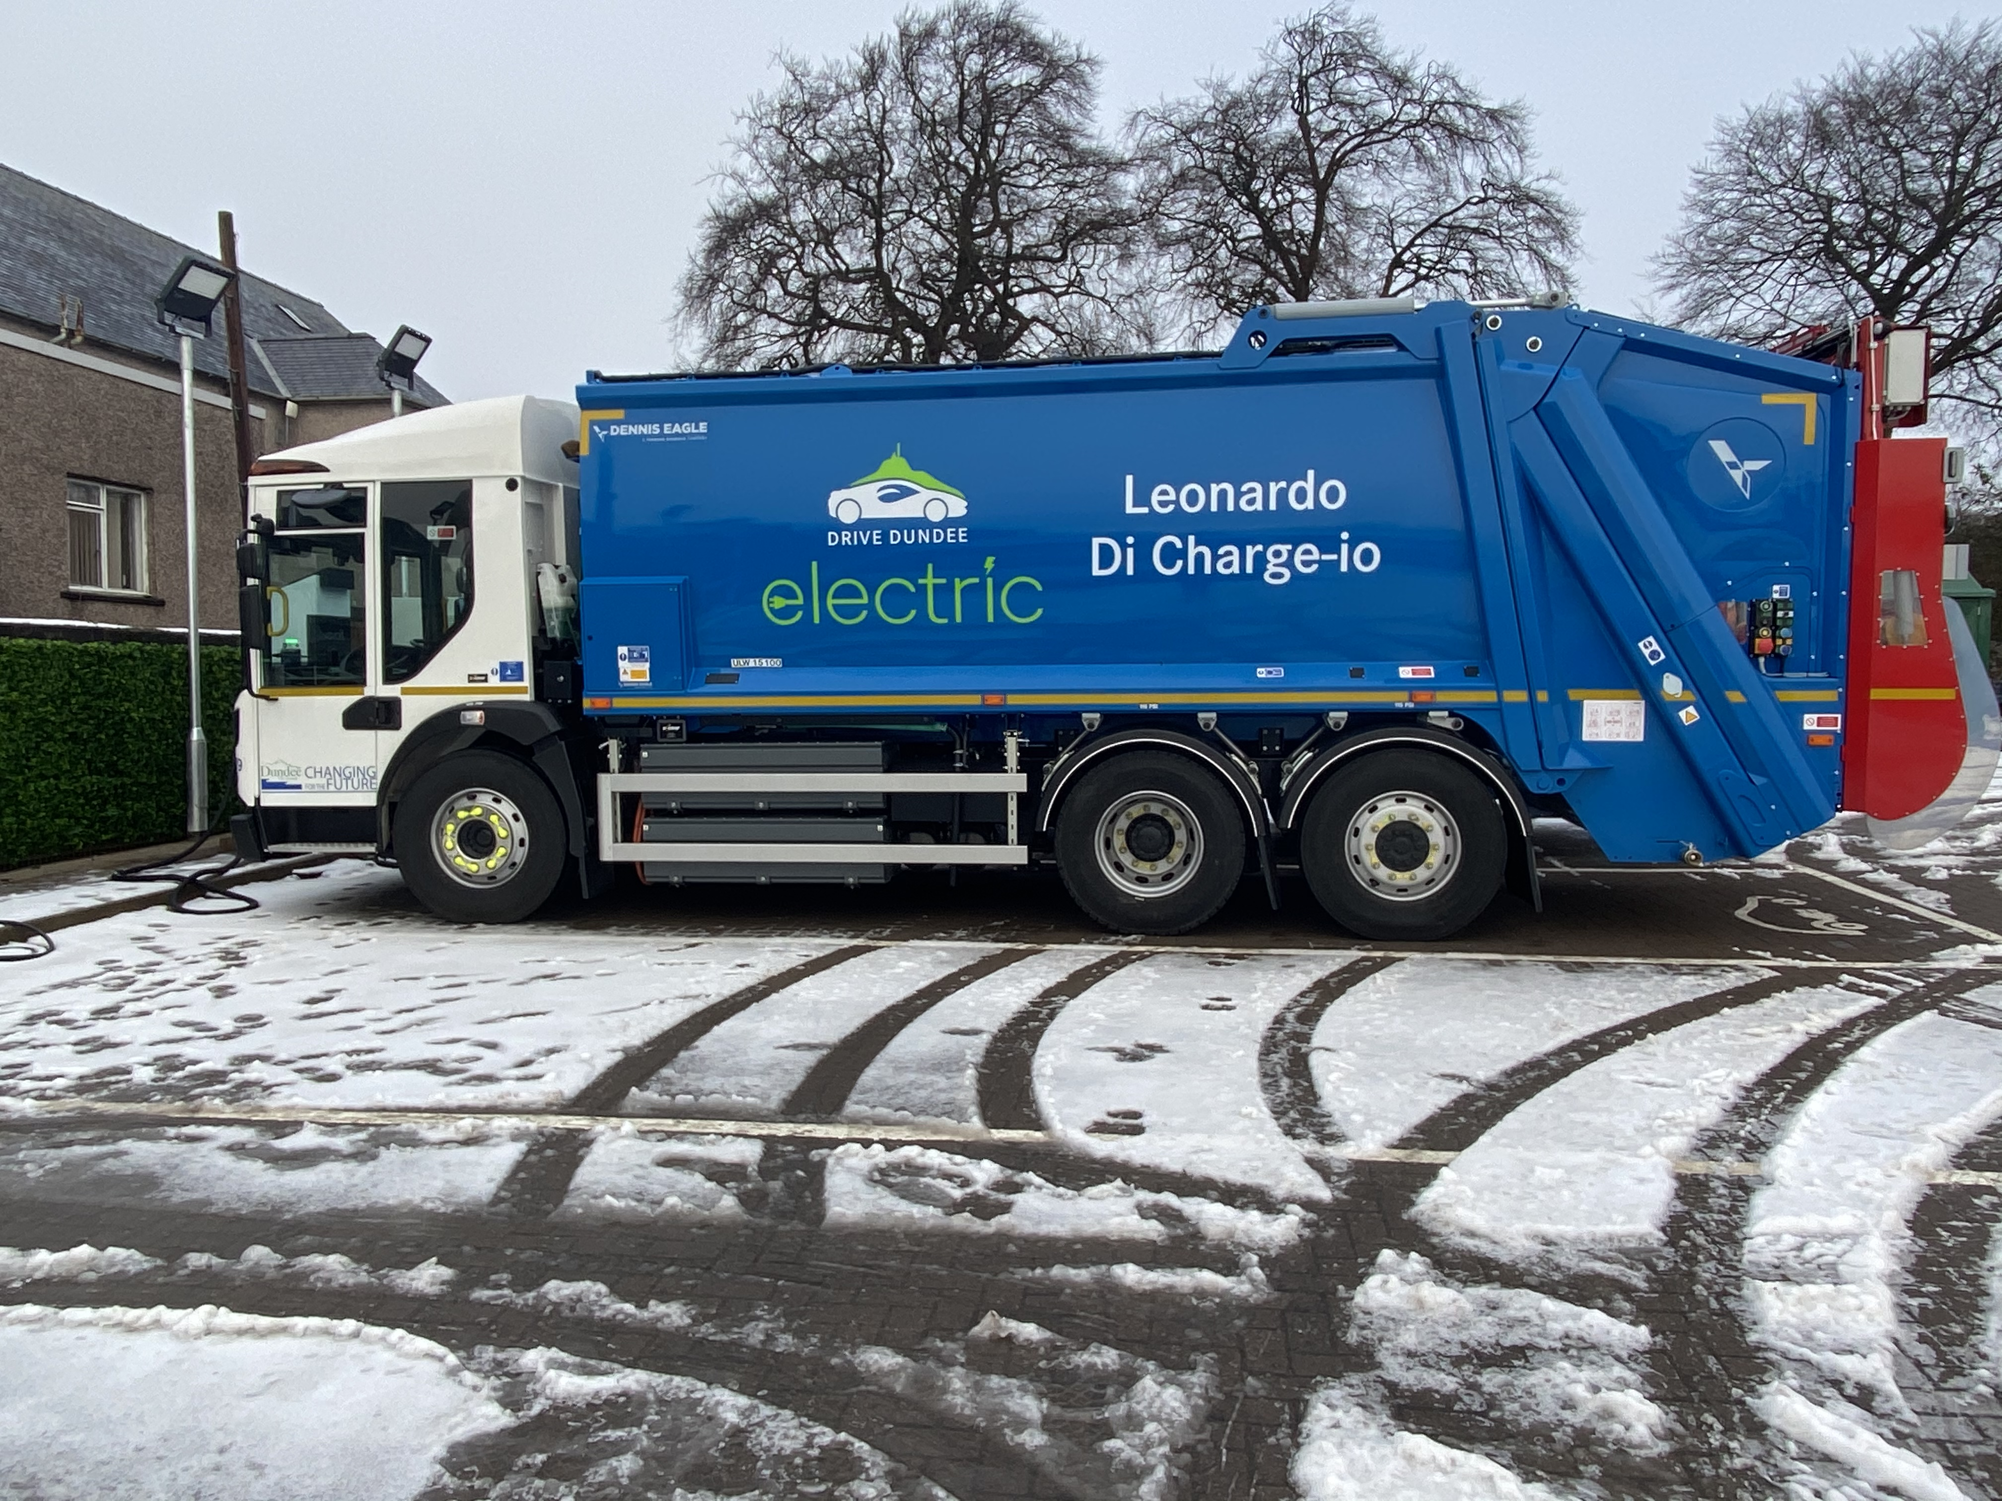
Transition to Electrification
25% Corporate Fleet Electric

Slide 8
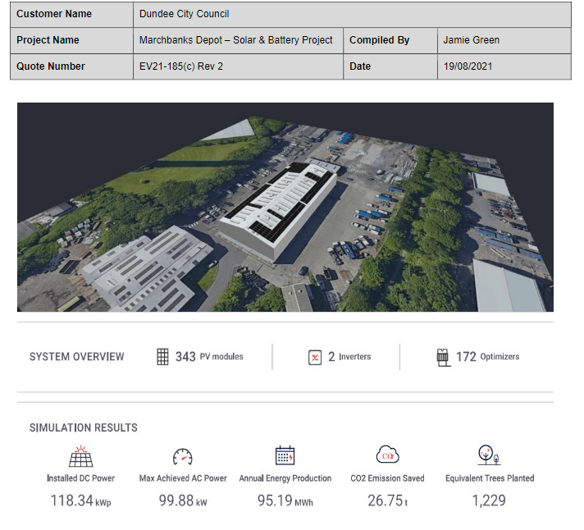
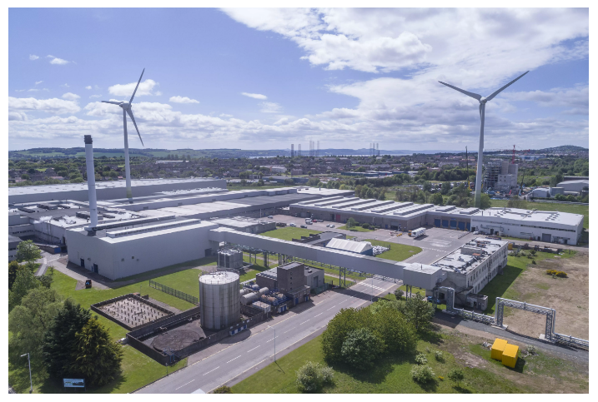
HGV EV INFRASTRUCTURE PROJECT

Slide 9


Princes Street EV Hub/Car Park
90kw Battery Storage
6 x 50kw 3 x 22kw chargers
3 EV hubs across the city, 4th hub built in 2021

Slide 10

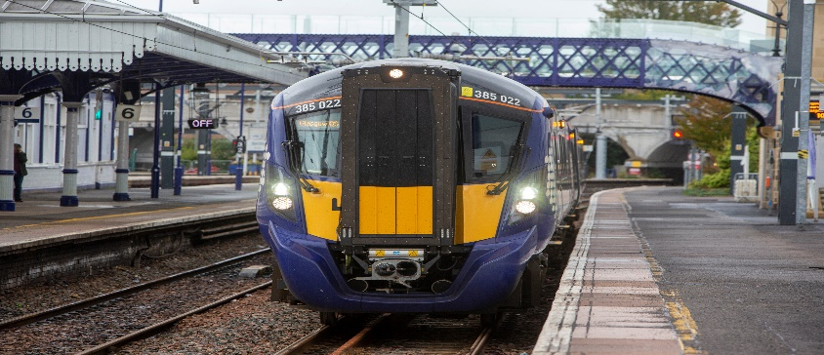
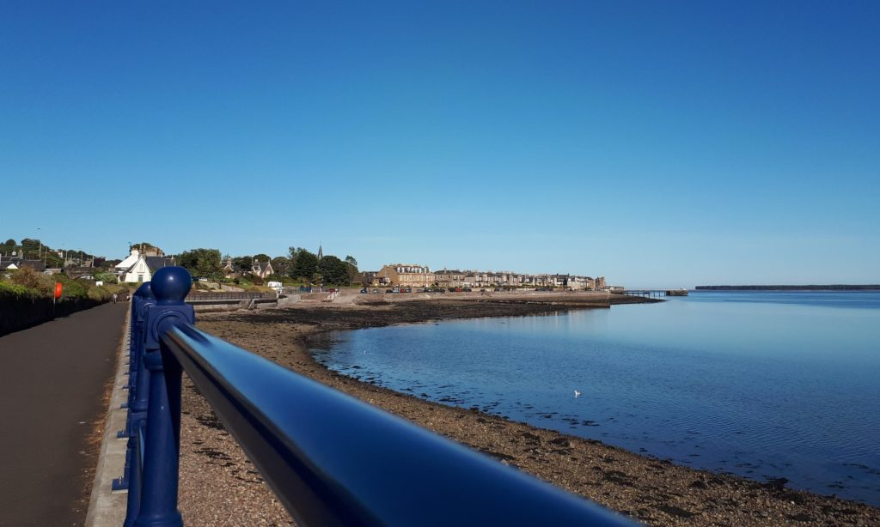
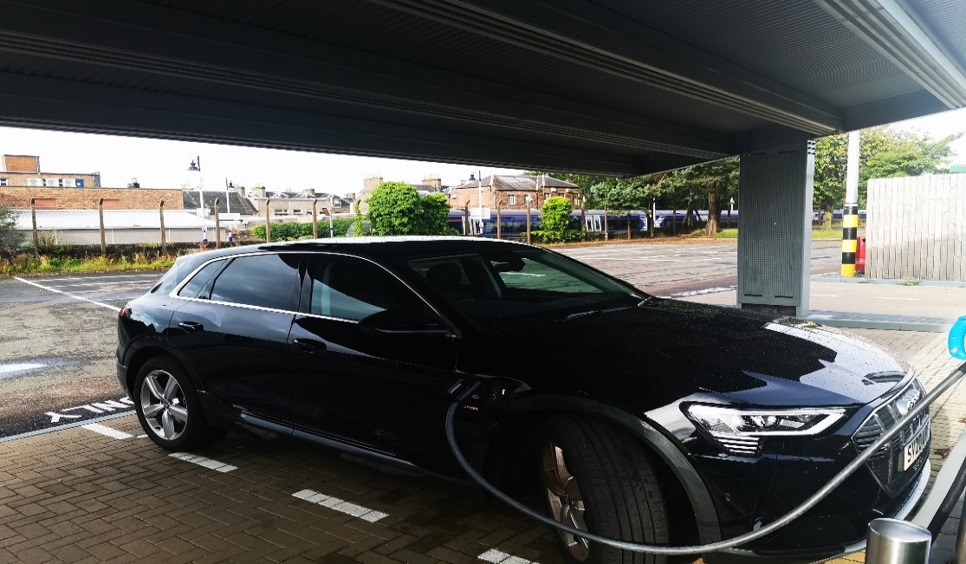
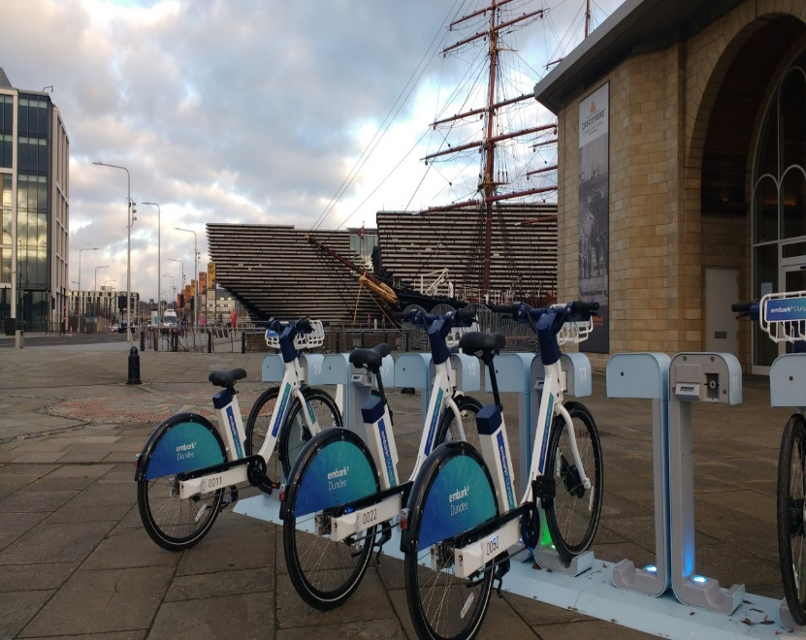

Strategy - Multi Modal EV Hub

Slide 11
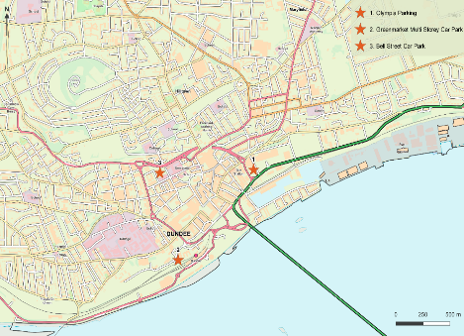
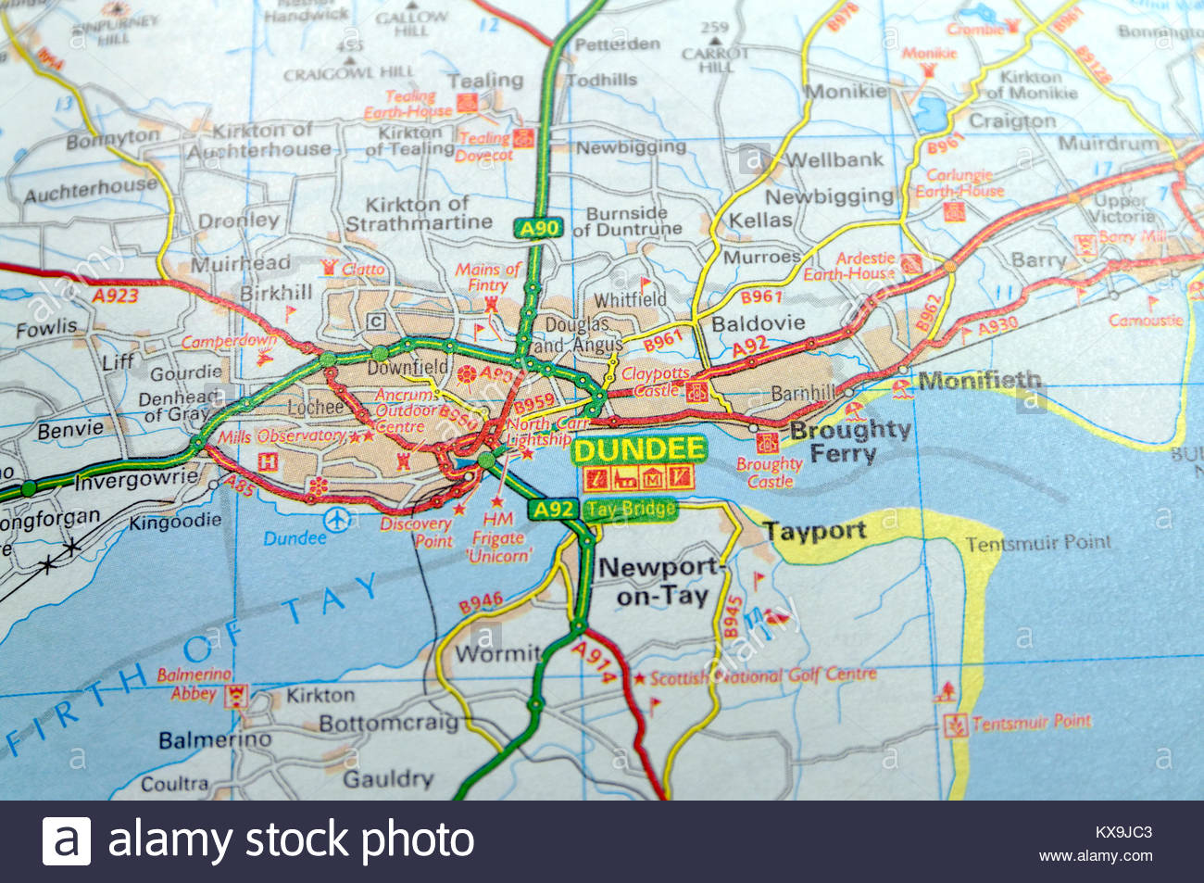
Multi-storey Car Park Charging Stations
Contains OS Data © Crown copyright and database rights 2017.

Slide 12
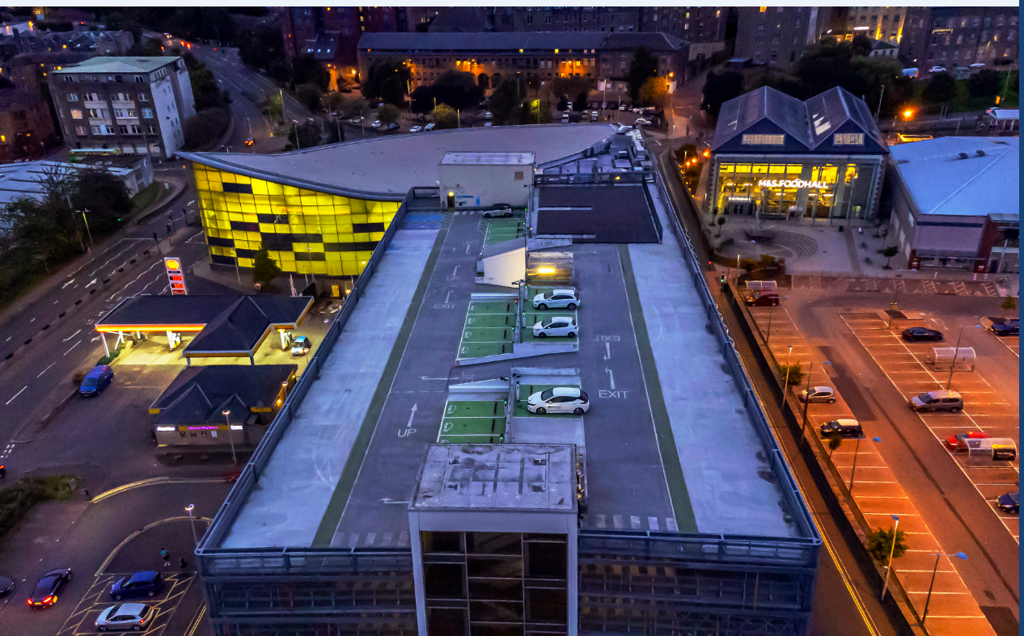
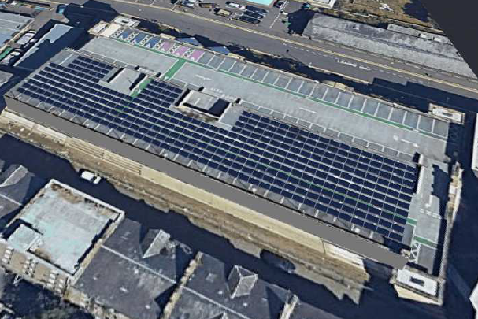
Multi-storey Car Parks

Slide 13
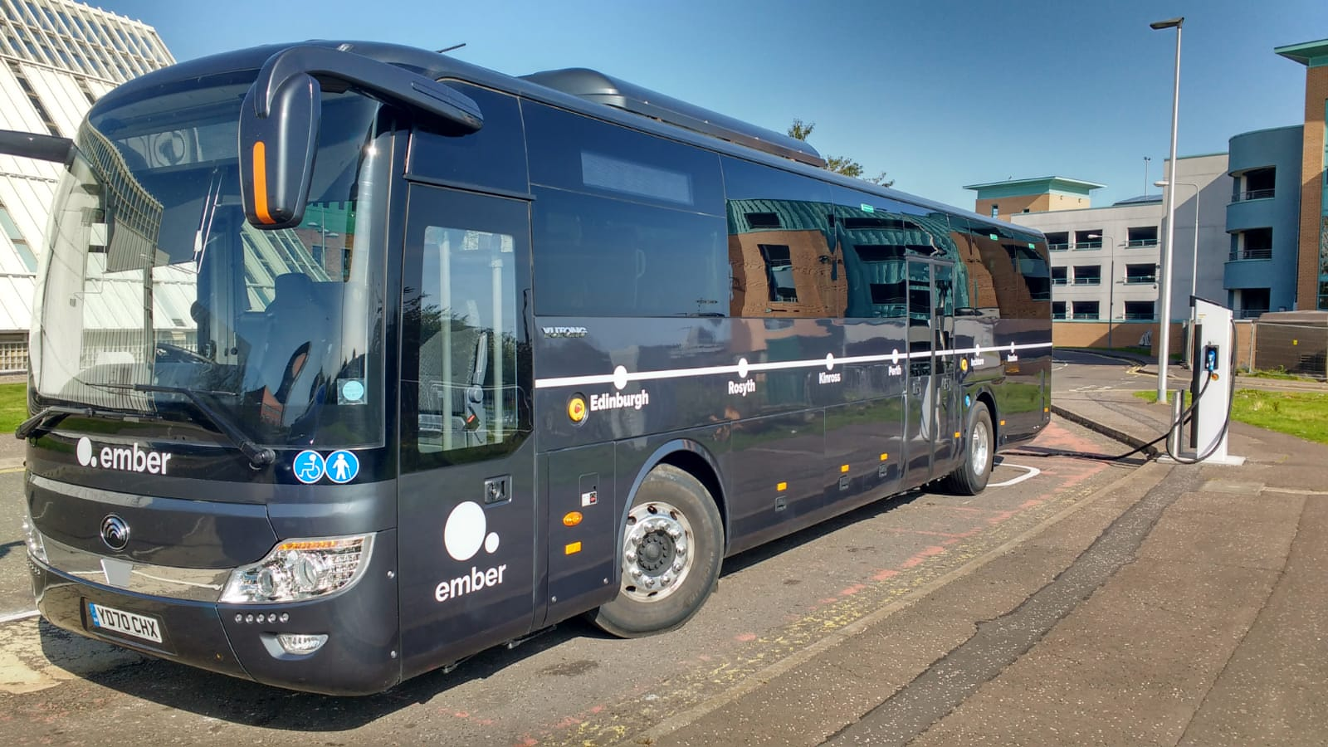
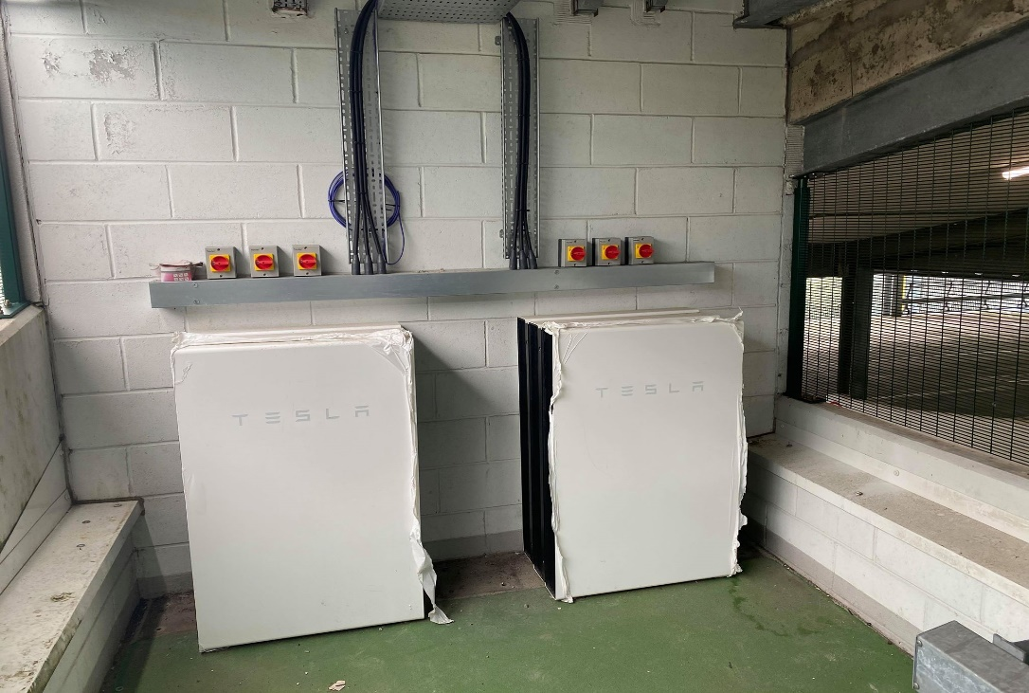
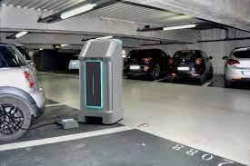
Flexibility to allow for constant innovation
Energy for future expansion

Slide 14

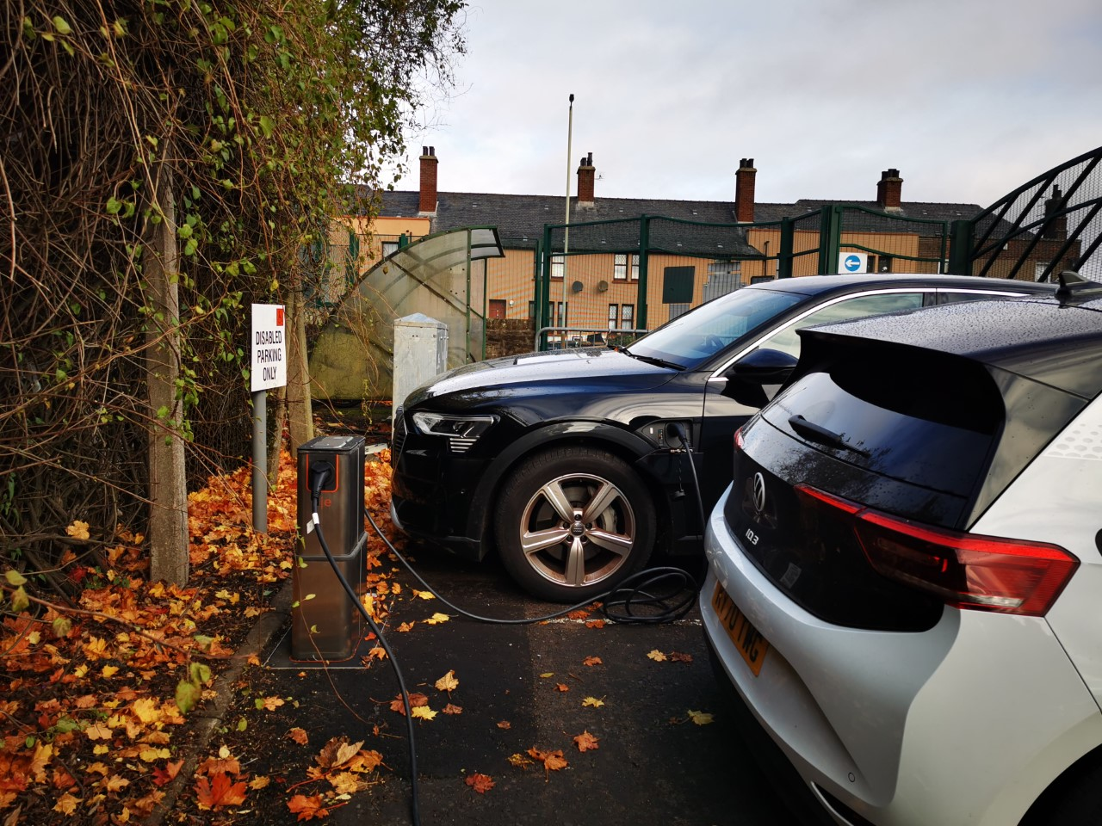
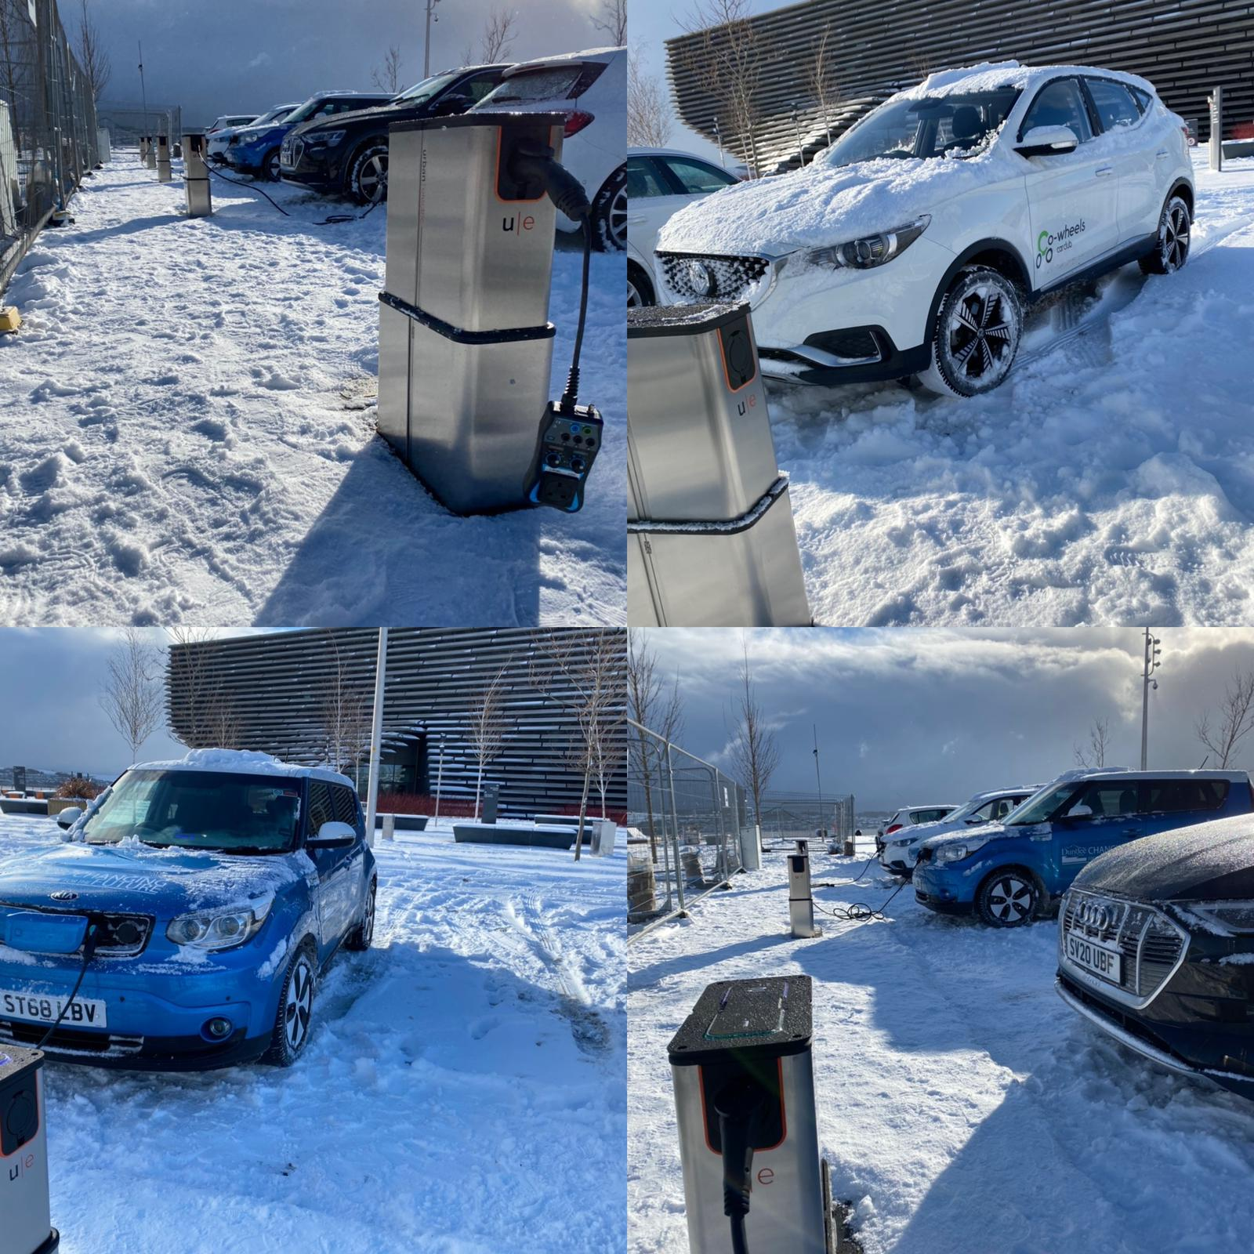
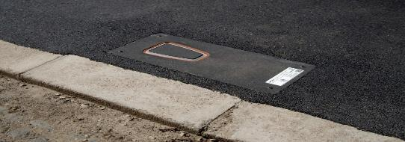
Residential EV Charging Solution
Pop-Up EV Chargers

Slide 15
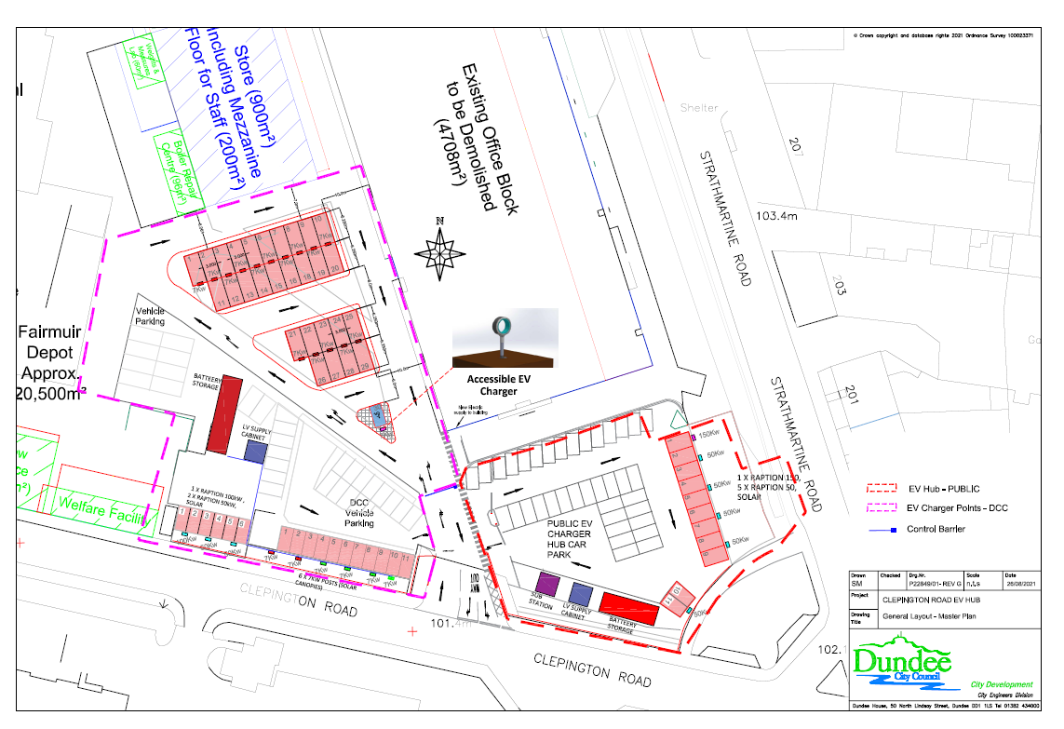
4th Hub/Depot Charging Infrastructure

Slide 16
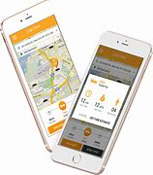
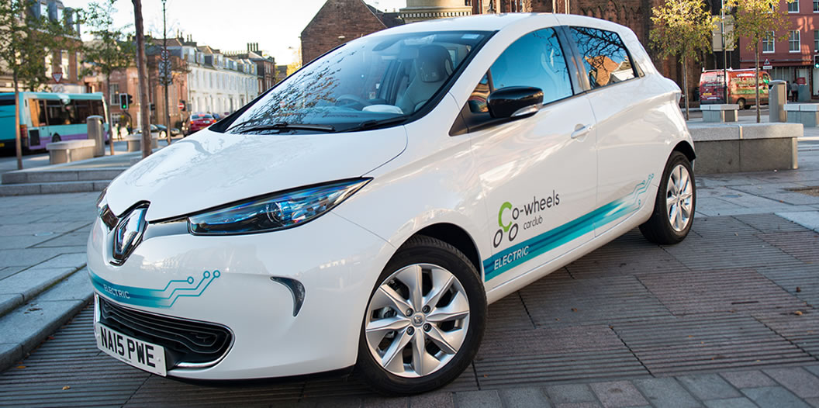


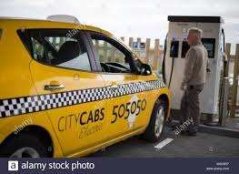
Integrated Mobility/Major Event
Smart Travel App
The Open St Andrews 2022
Electric Car Sharing
Electric Bike Sharing Project
Electric Taxis
Intercity Electric Coach

Slide 17
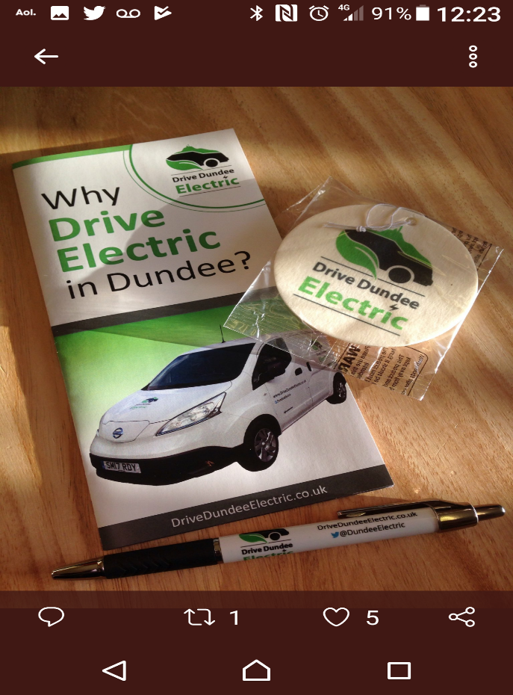

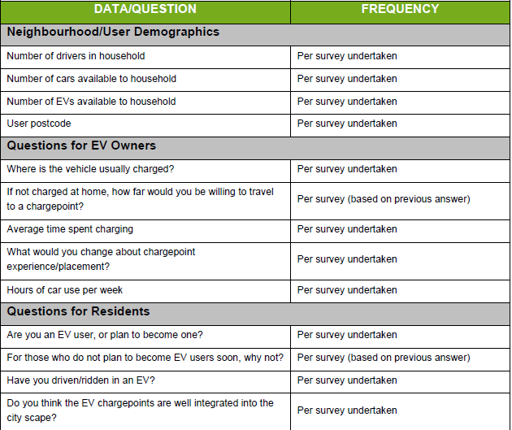
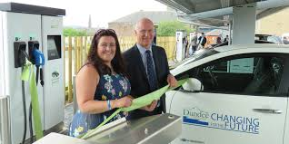
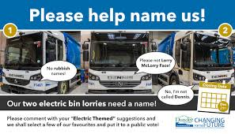

Marketing & Communication
drivedundeeelectric.co.uk

Slide 18
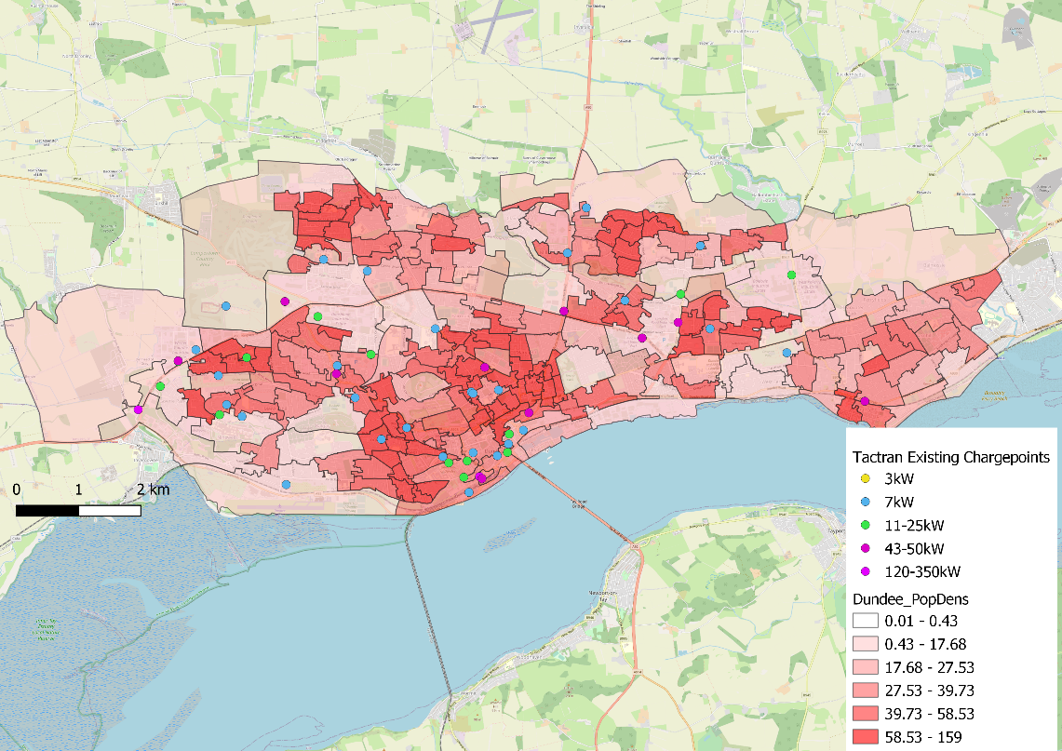
Dundee
Dundee than Region - Business Case
Notes:
Top left – St Marys
Top right – Fintry
Bottom left – Lochee Road/Perth Road
Bottom right - Barnhill

Slide 19
Thank You
Fraser Crichton
Corporate Fleet Manager
Dundee City Council
Dundee is Europe's most visionary EV city

