Slide 1

EV City Casebook and Policy Guide
EVI Pilot City Forum
November 2021
Gary McRae
Head of Electric Mobility

Slide 2
Overview
Introduction
1
EV City Casebook Overview
2
Policy Rec.
3
The Maturity Model
4
Dundee
Blueprint
5

Slide 3
Overview
Introduction
1
EV City Casebook Overview
2
Policy Rec.
3
The Maturity Model
4
Dundee
Blueprint
5

Slide 4
Overview
Introduction
1
EV City Casebook Overview
2
Policy Rec.
3
The Maturity Model
4
Dundee Blueprint
5

Slide 5

EV City Casebook Overview
Aims and Objectives
Deliverables
EV City
Casebook
Showcases city-level scale adoption of EVs
EV Project Scope
Produce a guide for cities aiming to benchmark their progress to date and seeking policy guidance to advance electrification
EV City
Policy Guide
Quantifies strategies and policies learning from best practice
urbanforesight.org
Notes:
Discuss how this is a collaboration project between HEV TCP and EVI

Slide 6
EV City Casebook Overview
Methodology
Data Gathering
Deliverables
Desk Research
Analysis & Evaluation
EV City Casebook
Interviews
Survey
EV Policy Guide
Workshops
urbanforesight.org

Slide 7





EV City Casebook Overview
Themes
Bus Service Electrification
Taxi & Ride Hailing Services
City
Fleets
Shared
Mobility
Private Transport
urbanforesight.org
Notes:
Icons?

Slide 8
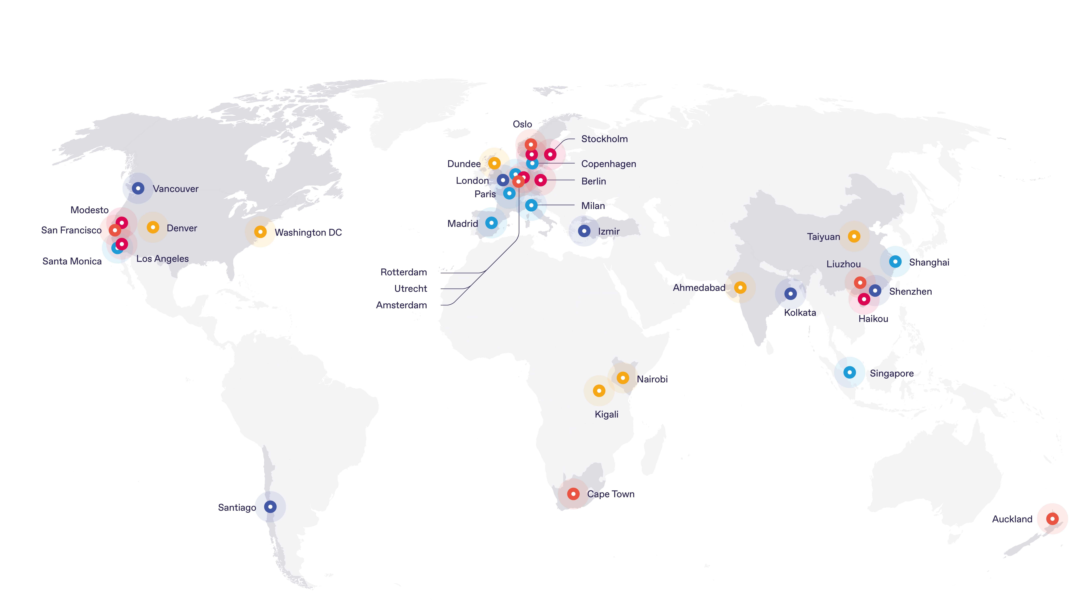
EV City Casebook Overview
Cities Features
Bus Service Electrification
Taxi & Ride Hailing Services
City
Fleets
Shared
Mobility
Private Transport
urbanforesight.org
Notes:
Icons?

Slide 9
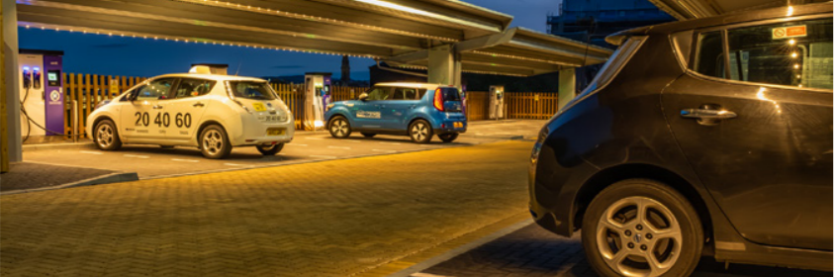
Dundee, Scotland
Taxi & Ride Hailing Services

Slide 10
Overview
Introduction
1
EV City Casebook Overview
2
Policy Rec.
3
The Maturity Model
4
Dundee
Blueprint
5

Slide 11
Challenges in scaling up
1
2
3
4
5
Long-term sustainability of incentives
Maturity of technology in larger vehicles
Social equity perceptions
Important policy levers at different levels of government
Need for integrated thinking with energy systems

Slide 12
Policy Recommendations
1
2
3
4
5
6
7
8
9
10
Set ambitious scale-up targets, backed up by achievable action plans.
Formal governance structures with a broad range of stakeholders working to a common vision.
Showing EV benefits across different aspects of public policy
Long-term planning in incentives
Leading by example
Direct relationships with manufacturers and technology providers
Adding responsive systems to infrastructure roll-out
Building resilience in infrastructure contracting and energy systems
Future-proofing for digital innovation.
Establishing social equity outcomes of EVs.

Slide 13
Overview
Introduction
1
EV City Casebook Overview
2
Policy Rec.
3
The Maturity Model
4
Dundee Blueprint
5

Slide 14

The maturity model
urbanforesight.org

Slide 15
Maturity model example: residential charging
 | BASIC | TACTICAL | STRATEGIC | INTEGRATED | OPTIMISED
 | Ad hoc provision | Financial and technical support to help individuals install charging at home | Shared plan with landlords, multi-unit dwellings and residents to roll out charging, with process to respond to requests for charging | Requirements for charging infrastructure to be included in all new developments | All homes have easy access to a charge point, with solutions for properties without dedicated parking and to maximise the use of off-peak electricity from renewables

Slide 16
Overview
Introduction
1
EV City Casebook Overview
2
Policy Rec.
3
The Maturity Model
4
Dundee Blueprint
5

Slide 17

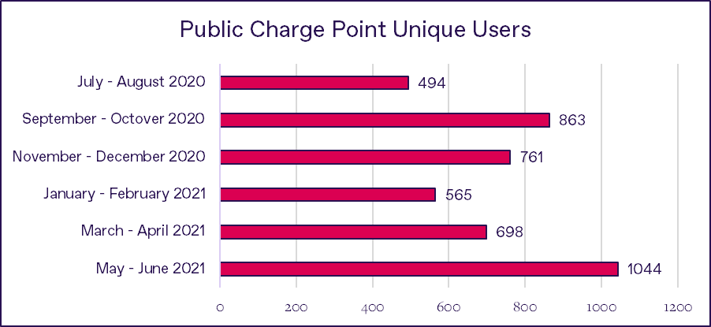
Dundee 2032

Slide 18
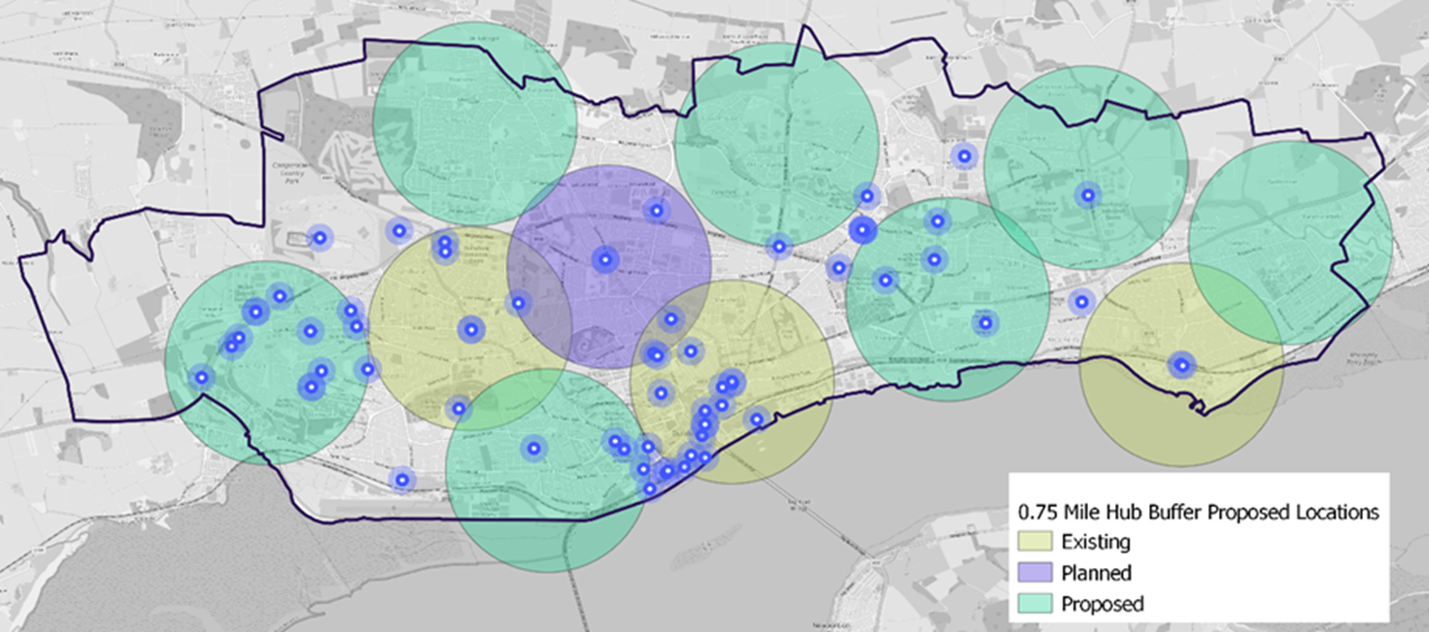
Dundee, 2045

Slide 19

EV city casebook 2021:
urbanforesight.org/publications/
Gary McRae
gary.mcrae@urbanforesight.org
© Urban Foresight Limited
+44 1382 549 946
urbanforesight.org
@urbanforesight
Flour Mill,
34 Commercial Street,
Dundee,
DD1 3EJ, Scotland
The Catalyst,3 Science Square, Newcastle Helix,
Newcastle upon Tyne,
NE4 5TG, United Kingdom

